Slide 1



DIRECT-TO-EMPLOYER PLAN
July 17, 2024

Slide 2
Why Direct-to-Employer (DTE)? It is time you have a say in your community's healthcare
Capture commercial pay market share
Connect employers and employees with St Luke's providers
Increase the census and directed care for St Luke's
Cut out carriers to lower the price of healthcare in the marketplace
Improve the health of the covered population

Slide 3

DIRECT-TO-EMPLOYER Focused on Self-Funded Employers
Employer and Re-Insurer assume all risk for the program
Employer is responsible for payment/funding of all fees, premiums, and claims
St Luke's Receives:
Fee-For-Service payments
Care Coordination fees (St Luke's)
Reimbursement for Standards of Care Services
Potential Upside Gain Sharing

Slide 4

Direct-to-Employer (DTE) Your plan focused on Your relationship with Employers
YOU Pick the Name of the Health Plan
YOU Determine the Fees Charged
YOU Practice the Medicine
YOU Receive the Profits
WE Make it Successful

Slide 5

Every $1 of Care
Government Pay
Commercial Pay
Creates
~$.31 of loss
Generates
~$.58 of profit
See Slides 38 for More Details on Calculation of Commercial and Government-Pay Net Income

Slide 6



BH DTE
PPO #1
PPO #2
PPO #3

Slide 7

Direct-to-Employer Strategy: Only Available to Premier Health Systems
STRONG Brand Quality
EXTENSIVE Patient Access
AFFORDABLE Value Pricing
EXCELENT Care Quality

Slide 8
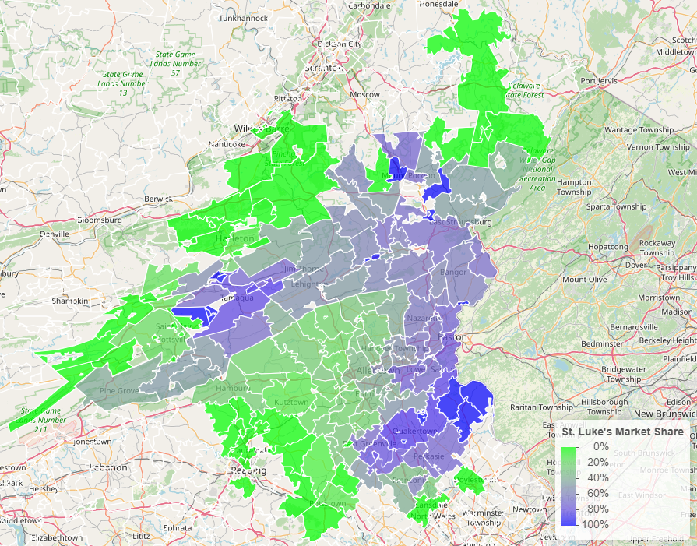
Strong Brand Quality
Comparison of Medicare payment market share by zip code: St Luke’s vs Lehigh Valley Health Network

Slide 9
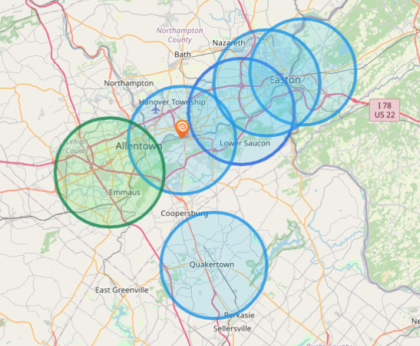
Extensive Patient Access
Hospital | Population Within 5 Miles
Lehigh Valley Hospital Cedar Crest | 227,393
Hospital | Population Within 5 Miles
St Luke's Hospital - Anderson Campus | 142,000
St Lukes Upper Bucks Campus | 46,000
St Luke's Hospital Bethlehem | 255,000
St Luke's Warren Hospital | 118,000
St Luke's Hospital - Easton Campus | 141,000

Slide 10

Cardiovascular Services | Cardiac Cath Lab
 | Cardiac Rehab
 | Cardiac Surgery
 | Carotid Stenting
 | Coronary Interventions
 | Electrophysiology
 | Vascular Intervention
 | Vascular Surgery
Emergency Services | Level 1 Trauma Certification
 | Pediatrics Trauma Certified
Neurosciences | Electroencephalography (EEG)
 | Sleep Studies
Oncology Services | Chemotherapy
 | Radiation Therapy
Organ Transplant | Kidney Transplant
 | Pancreas Transplant
Orthopedic Services | Arthroscopy
 | Joint Replacement
 | Spine Surgery
Other Services | Hemodialysis
 | Home Health
 | Hospice
 | Lithotripsy (ESWL)
 | Obstetrics
Radiology / Nuclear Medicine / Imaging | Computed Tomography (CT)
 | Computed Tomography-Angiography (CTA)
 | Digital Mammography
 | Intensity-Modulated Radiation Therapy (IMRT)
 | Magnetic Resonance Imaging (MRI)
 | Magnetic Resonance Angiography (MRA)
 | Positron Emission Tomography (PET)
 | Single Photon Emission Computerized Tomography (SPECT)
Rehabilitation Services | Physical Therapy
 | Speech Therapy
Special Care | Burn Intensive Care
 | Coronary Intensive Care (CCU)
 | Detox Intensive Care
 | Intensive Care Unit (ICU)
 | Neonatal Intensive Care
 | Pediatric Intensive Care
 | Surgical Intensive Care
 | Trauma Intensive Care
Subprovider Units | Psychiatric
 | Rehabilitation
 | Skilled Nursing (SNF)
Surgery | Inpatient Surgery
 | Radiosurgery
 | Robotic Surgery
Wound Care | Hyperbaric Oxygen
 | Wound Care

Slide 11

Excellent Care Quality
Patient HCAHPS Recommendation Rate Percentile | CMS Quality Stars Percentile | Mortality Average Percentile | Readmission Percentile
73% | 99% | 86% | 63%
53% | 58% | 72% | 63%
Source: CMS measurements of HCAHPS patient experience (percent who would strongly recommend), CMS Stars, high-variation mortality rates and high-variation readmission rates all shown as percentiles compared to all hospitals nationally, with the 99th percentile being the best.

Slide 12
Care at Value Pricing
Hospital | Rand Outpatient Services Percent of Medicare | Rand Inpatient Services Percent of Medicare
St Luke's Hospital - Anderson Campus | 290% | 280%
St Lukes Upper Bucks Campus | 292%
St Luke's Hospital Bethlehem | 287% | 214%
St Luke's Warren Hospital | 251%
St Luke's Hospital - Easton Campus | 212%
Lehigh Valley Hospital Cedar Crest | 315% | 249%
Source: RAND round 5 hospital cost data: https://www.rand.org/pubs/research_reports/RRA1144-2.html

Slide 13
FINANCIAL SUMMARY
DTE Covered Members Financial Analysis | DTE Covered Members Financial Analysis | DTE Covered Members Financial Analysis | DTE Covered Members Financial Analysis | DTE Covered Members Financial Analysis | DTE Covered Members Financial Analysis | DTE Covered Members Financial Analysis | DTE Covered Members Financial Analysis
All monetary values in thousands of dollars | All monetary values in thousands of dollars | All monetary values in thousands of dollars | All monetary values in thousands of dollars | All monetary values in thousands of dollars | All monetary values in thousands of dollars | All monetary values in thousands of dollars | All monetary values in thousands of dollars
DTE Members | Pre-DTE Revenue | Pre-DTE Margin | DTE Revenue | DTE Incr. Revenue | DTE Total Margin | DTE Incr. Margin | Net Margin Less DTE Fees
100 | $ 121K | $ 22K | $ 392K | $ 271K | $ 53K | $ 30K | $ -298K
500 | $ 604K | $ 111K | $ 1,961K | $ 1,356K | $ 263K | $ 152K | $ -172K
1,000 | $ 1,209K | $ 222K | $ 3,921K | $ 2,713K | $ 526K | $ 303K | $ -15K
2,500 | $ 3,021K | $ 556K | $ 9,803K | $ 6,782K | $ 1,314K | $ 758K | $ 458K
10,000 | $12,086K | $2,224K | $39,213K | $27,128K | $ 5,256K | $3,032K | $2,822K
20,000 | $24,171K | $4,448K | $78,426K | $54,255K | $10,512K | $6,063K | $5,973K
Note: DTE = Direct-to-Employer | Note: DTE = Direct-to-Employer | Note: DTE = Direct-to-Employer | Note: DTE = Direct-to-Employer | Note: DTE = Direct-to-Employer | Note: DTE = Direct-to-Employer | Note: DTE = Direct-to-Employer | Note: DTE = Direct-to-Employer
NOTE: Please see detailed financial analysis and assumptions used starting on page XX.
Financial projections do not include 340B contribution margin, which could represent $136 pmpm based upon optimizing 340B through plan design, St Luke's approved site(s) with network integration, and development of St Luke's’s proprietary PBM program.

Slide 14
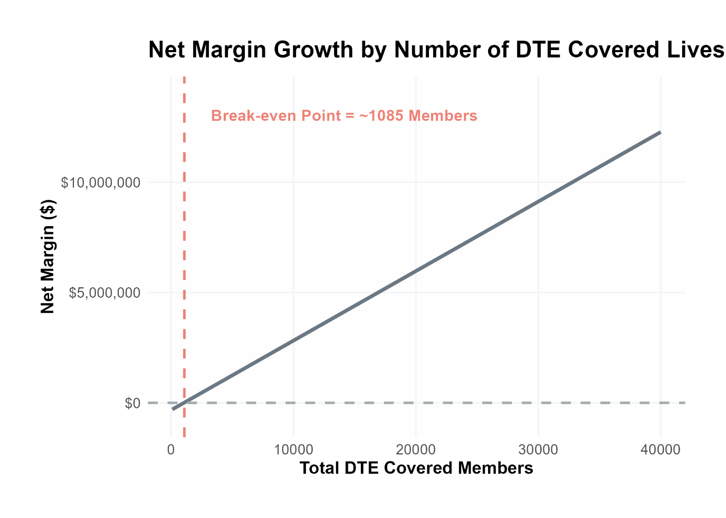
Core Model Assumptions
Commercial care margin is 29% (conservatively half of observed margin)
DTE pricing is 5% below current commercial levels (employers pay ~10% less but BH saves with easier billing)
32% inpatient market share
18% outpatient market share
FINANCIAL SUMMARY

Slide 15

DIRECT-TO-EMPLOYER Health Plan Strategy
“Directly” contract with self-funded employer(s) for FFS with potential for gain share – upside and downside possibilities
St Luke's is the “center” of the relationship with the employer – not an insurance carrier
Financially incent members to use St Luke's medical provider(s) and adhere to protocols intended to address gaps in care and to manage appropriate utilization

Slide 16

There Are 5 Main Reasons the DTE Program is Strategically Important for St Luke's:
1
2
3
4
5
Millions in NEW incremental net revenue and net margins
Control over your own network
Employers directly connect with St Luke's without a middleman for better patient care and lower costs
St Luke's has a complete employer health plan strategy and robust source of new fees and revenues - low financial and execution risk
Increases the ability to achieve the quadruple aim – increased member satisfaction, better outcomes, reduced cost, and provider satisfaction

Slide 17

Why does the DTE Strategy Work for St Luke's?
KBA has been successful in selling employer self-funded health plans for over 40 years without the added benefit of active integration by healthcare providers, or the lowest unit prices compared to the largest payers.
St Luke's can quantify its value proposition to employers as the lowest cost and highest quality provider using KBA’s proven population health management system from day one.
St Luke's can deploy a “turn-key” health plan for employer sponsored health plans in 6 months without the millions in capital contribution to start and operate an insurance company.
KBA provides St Luke's with a comprehensive sales, marketing, and social media system to promote St Luke's’s value proposition directly to the employer community while working with insurance agents and brokers to drive employer adoption.

Slide 18



Founded in 1979 and headquartered in Indianapolis, IN​
Full-service TPA specializing in the administration of self-funded health plans and population health management​
One of the country’s largest independently-owned TPAs
The Key Family is a commonly-held group of benefits related organizations with:​
3,000+ corporate clients​
3.0 million members under management​
Exclusive Relationship
We know The Market – Agents, Networks, and MGAs

Slide 19











Healthcare Leader in Private Labeled Plans
Companion Life
Crum & Forster
Fidelity Security
Kemper
National General
Transamerica
US Fire
University of Louisville Health (OneHealthPlan.net)
Anderson Regional Medical Ctr. (AffinityHealthPlan.net)
25 Independent Third Party Administrators
State of Indiana
Coefficient (Google)
CHS (NW AR)

Slide 20
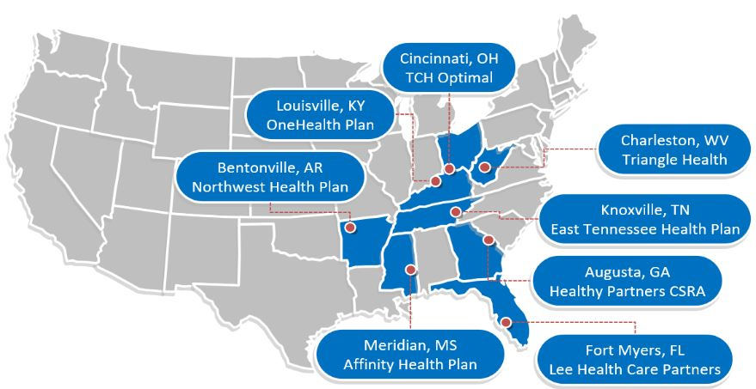
Healthcare Leader in Private Labeled Plans

Slide 21
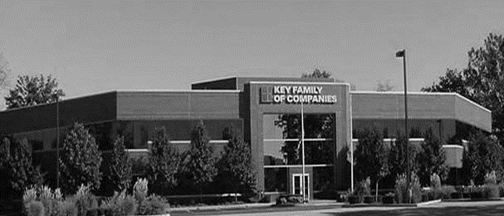



COLLABORATION OF STAKEHOLDERS
Key Benefit Administrators
Employer
Employee
St Luke's DTE
Full TPA Administration
Stop-Loss Administration
True Transparency & Analytics
Population Health Management
Utilization & Case Management
Sales & Marketing
Transparent PBM
Website & Mobile App
Customizable options & plans
Incremental Revenues and Margin
Branding & Messaging
Benefit Plan Integration
Network Steerage
Direct Employer/Member Access
Referral Authorization
Plan Transparency
Direct Access to Members
Reduced Spend
“At The Table” with St Luke's
Incentivized Gain Share Potential
Improved Analytics
Lower Stop-Loss
Stabilization
Healthier Population
Reduced Out of Pocket
Improved Health
Better Coordination of Health
Direct Access to the Best Medical Providers

Slide 22

BHS NETWORK
Out of Network
Friends & Family (Contracted)
Wrap Network (Rented)
ST LUKE’S Network
The medical providers in your direct control or are part of your delivery system.
Potential gain share distribution!
Friends & Family Providers – TIER 1
Access through direct contracts at the direction of St Luke's
WRAP NETWORK
Medical services from national PPO networks for members that travel, tertiary and specialty services you do not provide, and employees residing outside your direct catchment area
OUT OF NETWORK
Non-Contracted Medical Providers

Slide 23
Your Partner IN POPULATION HEALTH
Our population health management processes have been proven effective regardless of network affiliation or contracts
If St Luke's DTE program does nothing more than utilize our proven population health processes, this will be your result:
Greater Completion Rates for Standards of Care for the Chronically Ill
Reduced Employer Spend Regardless of the Contract Rates
Quantifiable 11%-17% in Reduced Employer Health Plan Costs
Adding St Luke’s managed care processes will only turbocharge the overall results – Truly Transformative in the Market Place
20%
Driving
80%
of Cost
ST LUKE’S CAN PROMOTE THESE RESULTS FOR YOUR OWN PROGRAM FROM DAY ONE!!

Slide 24
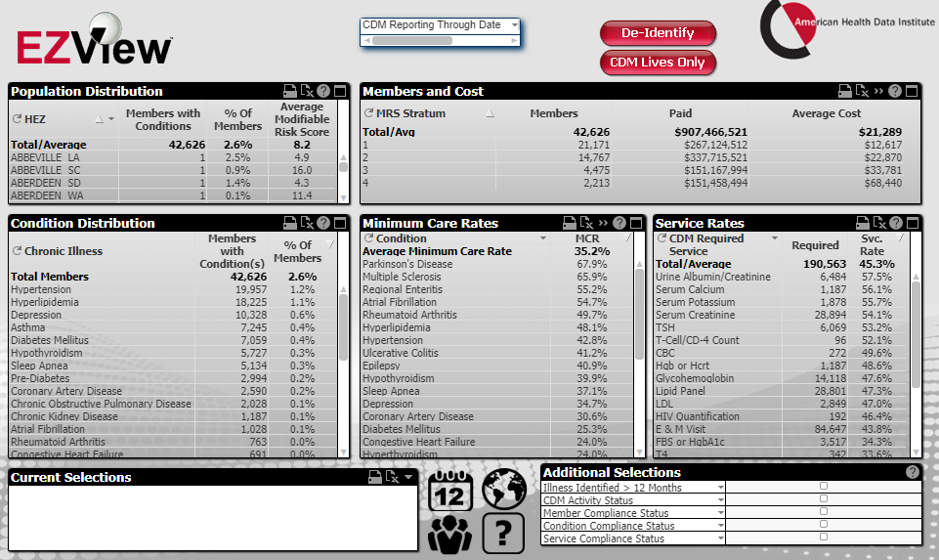
ACTIONABLE ANALYTICS BASED UPON SEVERITY OF ILLNESS AND GAPS IN CARE
All data available to St Luke's
All Patient, Provider, and Location Data Regardless of Network Affiliation
Identify the sickest of the sick
Monitor Compliance with Nurse Coaching and Triage to Providers
Identify Every Chronic Condition by Patient for Intervention
Regimens of Care for Chronic Illnesses

Slide 25
Using Evidence-Based standards of care for 27 chronic conditions and co-morbidities we can directly impact the overall cost of care substantially. For example, a diabetic that meets the prescribed standards of care for treatment can save a health plan over $6,000 per year over their lifetime (AHDI CDM Comparison of Regimens of Care for Diabetic Patients, 2017-2021). Good Health is Good Business
CHRONIC CONDITION | MINIMUM ANNUAL CARE RECOMMENDED
ASTHMA | 2 Clinical Evaluations 1 Spirometry (for patients 10 years of age or older)
ATRIAL FIBRILLATION | 1 Clinical Evaluation
CHRONIC OBSTRUCTIVE PULMONARY DISEASE | 1 Clinical Evaluation 1 Spirometry
CHRONIC VENOUS THROMBOTIC DISEASE previously listed as Thrombo-embolic Disease | 1 Clinical Evaluation
COPD WITH PULMONARY HYPERTENSION/COR PULMONALE | 2 Clinical Evaluations 12 months of supplemental 02 Tx
CHRONIC KIDNEY DISEASE | 1 Clinical Evaluation 1 Hgb or Hcrt | 1 Serum Creatinine 1 Serum Potassium | 1 Serum Calcium 1 Serum Phosphorus
CONGESTIVE HEART FAILURE | 1 Clinical Evaluation | 1 Serum Creatinine | 1 Serum Potassium
CORONARY ARTERY DISEASE | 1 Clinical Evaluation | 1 LDL
DEPRESSION | 1 Clinical Evaluation
DIABETES | 2 Clinical Evaluations 2 Glycohemoglobins 1 Serum Creatinine | 1 Lipid Panel IF no nephropathy Dx or ACE/ARB Rx, 1 Urine Albumin/Creatinine ratio, Total Protein
EPILEPSY | 1 Clinical Evaluation
HUMAN IMMUNODEFICIENCY VIRUS INFECTION | 2 Clinical Evaluations 2CBCs I T-Cell/CD-4 Count | 2 HIV Quantifications 1 Pap Smear (for women only, 21 years of age or older)
Hyperlipidemia | 1 Lipid Panel
HYPERTENSION | 1 Clinical Evaluation | 1 Serum Creatinine
HYPERTHYROIDISM | 1 Clinical Evaluation | 1 TSH | 1 T4
HYPOTHYROIDISM | 1 Clinical Evaluation | 1 TSH
METABOLIC SYNDROME | 1 Clinical Evaluation | 1 Lipid Panel | 1 FBS or HgbA1c
MULTIPLE SCLEROSIS | 1 Clinical Evaluation
PARKINSON'S DISEASE | 1 Clinical Evaluation
PERIPHERAL ARTERIAL DISEASE (ATHEROSCLEROSIS] previously listed as Peripheral Vascular Disease | 1 Clinical Evaluation 1 LDL
PRE-DIABETES | 1 Clinical Evaluation | 1 Lipid Panel | 1 FBS or HgbA1c
POLYMYALGIA RHEUMATICA | 2 Clinical Evaluation | 2 ESR or CRP | 1 CBC
PULMONARY HYPERTENSION (UNRELATED TO COPD) | 2 Clinical Evaluation
REGIONAL ENTERITIS (INFLAMMATORY BOWEL DISEASE) | 1 Clinical Evaluation
RHEUMATOID ARTHRITIS | 1 Clinical Evaluation
SLEEP APNEA | 1 Clinical Evaluation
ULCERATIVE COLITIS (INFLAMMATORY BOWEL DISEASE) | 1 Clinical Evaluation
PROVEN POPULATION HEALTH MANAGEMENT
CHRONIC DISEASE MANAGEMENT
The chronic diseases identified include a list of services (i.e. exams, lab work and diagnostics) rendered by a network provider payable at 100% and not subject to the deductible or copay.

Slide 26

Transparent PBM Integration
Support of St Luke’s retail pharmacy(s)
Optimize St Luke’s 340B drug pricing program
Allows St Luke's to create their own PBM program
Custom telephone number with personalized scripting and separate call tracking & reporting
Fully customizable member welcome booklet & materials
White labeled formulary document and marketing materials
CUSTOM CLIENT SUPPORT:
Specialized call center capabilities
Fully customizable plan designs
Operational access to the platform
Customized process and functions to promote DTE strategy
CLINICAL FLEXIBILITY:
Full portfolio of custom formulary offerings – with optimized formulary shield
Clinical programs that drive towards overall DTE strategy
Options for additional drug savings by driving members to lower cost alternatives
Flexibility to customize or layer on utilization management programs

Slide 27
STOP-LOSS INSURANCE
Gerber Life Insurance
Nationwide
Sirius Group
Sun Life
Liberty Mutual
Granular (Google)
Companion Life
Crum & Forster
American Fidelity
RGA
KBA has over 20 stop-loss underwriters and carriers that we work with on core employer sponsored plans and DTE;
KBA performs a comprehensive analysis of each stop-loss partner in order to approve them for our business;
KBA provides comprehensive pricing and medical service analysis for each DTE to ensure proper pricing;
KBA is also evaluated by the stop-loss markets in order to be an approved claims payer for them;
KBA provides the administration required of the stop-loss markets:
Bordereau Reporting;
Claim Reporting and Reconciliation;
Evaluation of Networks;
Care Management;
Initial Underwriting;
Negotiation of rates and terms; and
Plan Design Actuarial

Slide 28

BENEFITS FOR THE EMPLOYER
Reduced medical spend through care control
“At the table” with St Luke's
Incentivized medical partners
Improved and “superior” analytics
Competitive stop-loss
Increased flexibility
Increased cash flow & stabilization of cost

Slide 29
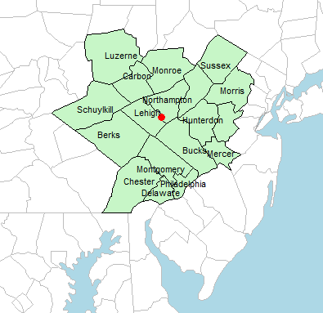

DEMOGRAPHICS 21,000+ Employers 244,000+ Employees 536,000+ Members
CHATTANOOGA MSA
 | EMPLOYERS | EMPLOYEES | MEMBERS
2 TO 9 | 14,372 | 43,116 | 94,855
10 TO 19 | 4,384 | 48,224 | 106,093
20 TO 49 | 1,947 | 64,251 | 141,352
50 TO 99 | 328 | 20,008 | 44,018
100 TO 249 | 174 | 25,926 | 57,037
250-499 | 51 | 13,974 | 30,743
500 TO 999 | 19 | 10,887 | 23,951
1,000 TO 4,999 | 12 | 17,676 | 38,887
5,000 + | 4 | 21,756 | 47,863
 | 21,291 | 244,062 | 536,936
PA Data Coming

Slide 30

PLAN DESIGNS THAT OPTIMIZE PLAN STEERAGE TO ST LUKE’S
Exclusive Provider Organization (EPO) Plan Design Structure

Slide 31

DTE PROGRAM MARKETING & SALES
KBA WORKS WITH YOU TO MANAGE & SELL:
Branding & Messaging
Direct & Brokerage Sales Distribution – Focused Sales Representative
Brochures, Web Site, Media, etc.
Stop-Loss/Level Funded Down to 2 EE Lives
Sell Through Established Brokers in Your Service Area

Slide 32

Complete Sales Distribution System
BROKER DEVELOPMENT
Identification of Key Distribution Agents
Training and Development
DIRECT SALES
Identification of Key Targets
Working with St Luke's on Specific Employers
SALES ADMINISTRATION
Quote System
Quote Evaluation
Compensation
Meet and Greet
Sales Process
Closing
Stop Loss Negotiations
Reporting & Analysis
Proposal Development

Slide 33
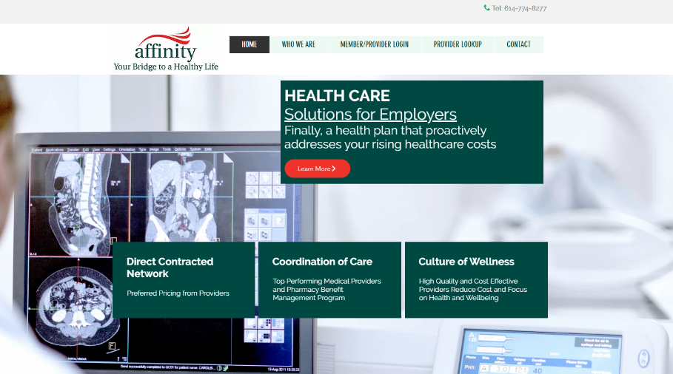








Complete Marketing System
Customized Branding and Messaging
Customized Brochures
Customized Web Site
Targeted Employer Outreach
Sales System (Social Media, Email, Text, etc.)

Slide 34

DTE COLLABORATION
KBA
Full Health Plan Administration
Direct Contracting on Behalf of St Luke's
Wrap Networks For Gaps And Members In Other Areas
Acquire & Retain Customers
Population Management
Transparent PBM
Stop-loss
Employer/Broker Support
Tier 1 Provider Network
Population Management
Medical Director oversight
Local Provider Recruitment
Network Management

Slide 35
ROLES & RESPONSBILITIES
SERVICES & ADMINISTRATIVE SYSTEMS PROVIDED BY:
St Luke's | KBA Operations
Tier 1 Provider Network Provider Recruitment – If Necessary Network Pricing & Contract Terms Referral Management Protocols & Approvals Medical Director Oversight Practice Improvement Program using KBA/AHDI Data with Assistance from KBA Gain Sharing Determination Physician Formulas – With KBA Assistance Hospital Formulas – With KBA Assistance | Network Evaluation – Actuarial Pricing PPO Wrap & Tertiary Transplant Network, if needed Claims Administration Plan Design Development, Testing, and Administration Employer/Member/Provider Customer Service Customized Member/Provider/Agent/HR Portal Billing, Enrollment (Electronic/Paper), and Premium Management Fulfilment – SPD & Customized ID Cards COBRA/HIPAA Administration Out of Network Negotiations Wrap PPO Repricing Nurse Coaching for Chronically Ill Nurse Triage to Physicians and Facilities Stop-Loss Underwriting, Pricing, and Placement Stop Loss Claims Administration Complex Case Management PBM Administration Interface Reporting Utilization & Gaps in Care Clinically Based Physician Profiling Referrals Gain Share Calculations & Distribution Chronic Disease Management Employer Health Risk Management Reports Ancillary Administration – Dental, Vision, Weekly Income, 5500, Life, etc. Health Savings Account (HSA), Flexible Spending (FSA), Health Reimbursement Account (HRA) Administration Sales & Marketing Plan Strategy Development: Branding, Brochures, Web Site Distribution System Development Sales Management
KBA Consulting
Program oversight and integration across the enterprise Goal development, agreement and tracking Start-up assessments: market, network, operational and readiness Draft business plan with financial projections Facilitate program communication and engagement with St Luke's departments including system c-suite, operations, HR, managed care, marketing, strategy and business development

Slide 36


FINANCIAL PROJECTIONS & ASSUMPTIONS

Slide 37
Estimation of SL 2021 Inpatient Payer Mix
Payer Group | Total Inpatient Days | Revenue | Payer Mix
All Little-Rock Area BH | $281,887 | $6,719,041K | 100%
Medicare | $89,723 | $2,290,492K | 32%
Medicaid | $18,822 | $533,554 | 7%
Other Government Pay | $0 |  | 0%
No-Pay, Charity Care | $13,939 | $87,341 | 1%
Commercial/Self Pay | $980,425 | $3,894,994 | 61%
Estimating Payer Mix
Medicare, Medicaid, and other government payer mixes are estimated as the percentage of inpatient days for each group divided by total inpatient days.
No-pay and charity care is estimated as the percentage of no-pay/charity care compared to total overall revenue.
Commercial/self pay is assumed to be the rest of the total payer mix share.
Estimating Revenue by Group
Medicaid and Other Government Pay are estimated to be paying the same rate per inpatient day as Medicare (a conservative assumption).
Commercial/Self Pay is assumed to be all revenue not known to be paid by Medicare and not assumed to be paid by Medicaid or other government pay.
Values in blue are taken from the 2021 Medicare Provider Cost Report (https://data.cms.gov/provider-compliance/cost-report/hospital-provider-cost-report/data)
Total Medicare patient revenue is reported by CMS in the Medicare Provider Analysis and Review Report (MedPAR)
Estimating Total Inpatient Days
Total inpatient days for ‘No Pay’ and ‘Commercial’ are estimated to be the payer mix estimates for “No Pay, Charity Care” and “Commercial/Self Pay” multiplied by the total number of inpatient days.
In other analysis, the outpatient payer mix is assumed to mirror the inpatient payer mix.

Slide 38
Estimation of Margin for Commercial vs. Government Pay
Estimation of Margin for Commercial vs. Government Pay
The RAND estimate for St Luke's that commercial insurance is paying at 233% of Medicare Rates
Estimating Commercial Margin
(Calculated through counterfactual of assuming all CMS/Government pay was paying at commercial rates)
Estimating Gov-Pay Margin
(Calculated through counterfactual of assuming all commercial pay was paying at Medicare rate)
Commercial Revenue | $3,894,994
Gov-pay revenue at CM13% current rate | $6,568,734
Total Revenue | $10,463,728
Total Costs | $6,608,088
Net Income | $3,855,639
 | 37%
Commercial Revenue Divided by 203% | $1,674,546
Gov-pay revenue | $2,824,047
Total Revenue | $4,498,593
Total Costs | $6,608,088
Net Income | $2,109,495
 | -47%

Slide 39
Estimating Market Share
Hospital Name | Number of Beds | Inpatient Total Charges | Outpatient Total Charges | Inpatient Percent of Market Total | Outpatient Percent of Market Total (Assuming 56% of Physicians Employed by Hospitals)
St Luke's Warren Hospital | 92 | $ 368,161.2K | $ 628,908.6K | 2% | 2%
St Lukes Quakertown Hospital | 59 | $ 279,999.3K | $ 443,390.2K | 2% | 1%
St Luke's Hospital Bethlehem | 476 | $3,198,742.0K | $2,640,398.0K | 21% | 9%
St Luke's Hospital - Easton Campus | 164 | $ 352,608.5K | $ 429,718.2K | 2% | 1%
St Luke's Miners Memorial Hospital | 49 | $ 122,533.8K | $ 316,335.6K | 1% | 1%
St Luke's Hospital - Anderson Campus | 146 | $ 680,242.5K | $1,131,691.6K | 4% | 4%
Hunterdon Medical Center | 184 | $ 301,818.9K | $ 448,678.7K | 2% | 1%
Lansdale Hospital | 140 | $ 176,684.4K | $ 164,286.6K | 1% | 1%
Reading Hospital | 538 | $1,593,063.7K | $1,526,971.0K | 10% | 5%
Grand View Health | 155 | $ 229,623.2K | $ 316,907.9K | 1% | 1%
Pottstown Hospital | 183 | $ 465,072.2K | $ 441,982.0K | 3% | 1%
Lehigh Valley Hospital |  | $4,967,638.2K | $5,033,370.6K | 32% | 17%
Lehigh Valley Hospital - Hazleton | 122 | $ 214,053.4K | $ 443,957.1K | 1% | 1%
Lehigh Valley Hospital - Pocono | 217 | $ 473,920.8K | $ 739,891.7K | 3% | 2%
Doylestown Hospital | 239 | $ 482,710.4K | $ 638,299.8K | 3% | 2%
St Mary Medical Center | 348 | $ 836,819.8K | $ 695,324.9K | 5% | 2%
Physicians Care Surgical Hospital | 12 | $ 83,225.4K | $ 88,359.5K | 1% | 0%
St Luke's Hospital - Monroe Campus | 98 | $ 542,096.7K | $ 704,753.1K | 4% | 2%
For outpatient market share, it is estimated that only 56% of local physicians are employed by area hospitals (Research from the Physician Advocacy Institute: https://www.physiciansadvocacyinstitute.org/Portals/0/assets/docs/PAI-Research/PAI-Avalere%20Physician%20Employment%20Trends%20Study%202019-2023%20Final.pdf?ver=uGHF46u1GSeZgYXMKFyYvw%3d%3d)

Slide 40
ATTACHMENT B – PLAN DESIGN STEERAGE
 | DTE Health Plan Utilization by Tier - DTE 2022-2023 YTD
 | Charges | % | Paid | % | Discount Equivalent
 |  |  |  |  | Charge to Paid
Tier 1 |  | 81.26% |  | 77.42%
DTE 1 | $ 17,913,805.69 | 54.82% | $ 6,907,327.88 | 58.63% | -61.44%
DTE 2 | $ 8,460,570.40 | 78.37% | $ 3,280,571.45 | 77.62% | -61.23%
DTE 3 | $ 629,748.27 | 72.98% | $ 198,216.95 | 80.64% | -68.52%
DTE 4 | $ 58,261,069.02 | 96.15% | $ 12,968,046.77 | 93.20% | -77.74%
 | $ 85,265,193.38 |  | $ 23,354,163.05
DTE Steerage Impact on an EPO Plan Structure

Slide 41
Hospital Metrics | Hospital Metrics | Hospital Metrics | Hospital Metrics | Hospital Metrics | Hospital Metrics | Hospital Metrics
Metric | St Luke's Hospital Bethlehem | St Luke's Hospital - Anderson Campus | St. Luke's Upper Bucks Campus | St Luke's Miners Memorial Hospital | St Luke's Warren Hospital | St Luke's Hospital - Easton Campus
Total Hospital Days | 175,348 | 50,266 | 22,200 | 10,032 | 19,488 | 4,553
Total Medicare Days | 52,829 | 15,729 | 6,831 | 4,324 | 8,271 | 1,739
Total Medicaid Days | 11,581 | 4,726 | 1,513 | 210 | 653 | 139
Total Other Government Payer Days | 0 | 0 | 0 | 0 | 0 | 0
Total Inpatient Patient Revenue | $4,405,903K | $1,147,293K | $445,030.1K | $148,635.9K | $476,397.8K | $95,781.93K
Total Outpatient Patient Revenue | $4,200,213K | $1,399,166K | $622,566.5K | $391,107.5K | $893,500.7K | $266,747.9K
Total Medicare Revenue | $1,429,700K | $388,982.3K | $180,820.5K | $54,446.66K | $201,411.5K | $35,132.22K
Estimated Medicaid and Other Government-Pay Revenue | $337,708.1K | $125,411.7K | $43,999.84K | $4,049.943K | $18,222.38K | $4,162.523K
Estimated Commercial Revenue | $2,638,495K | $632,899K | $220,209.8K | $90,139.27K | $256,763.9K | $56,487.18K
Total Uncompensated Care | $44,285.54K | $17,607.8K | $7,224.374K | $6,073.798K | $6,732.363K | $5,417.753K
Estimated Inpatient Costs | $4,331,130K | $1,120,753K | $444,925.3K | $146,792.1K | $467,292.5K | $97,195.85K
Estimated Outpatient Costs | $4,128,932K | $1,366,800K | $622,419.8K | $386,255.9K | $876,423.4K | $270,685.6K
Estimated Total Costs | $8,460,062K | $2,487,552K | $1,067,345K | $533,048K | $1,343,716K | $367,881.4K
Net Income | $190,339.8K | $76,514.7K | $7,475.856K | $12,769.15K | $32,914.92K | $66.121K
Estimated Payer Mix Percent Medicare | 30.1% | 31.3% | 30.8% | 43.1% | 42.4% | 38.2%
Estimated Payer Mix Percent Medicaid | 6.6% | 9.4% | 6.8% | 2.1% | 3.4% | 3.1%
Estimated Payer Mix Percent Other Government-Pay | 0.0% | 0.0% | 0.0% | 0.0% | 0.0% | 0.0%
Payer Mix Percent No Pay | 0.5% | 0.7% | 0.7% | 1.1% | 0.5% | 1.5%
Estimated Payer Mix Percent Commerical | 62.8% | 58.6% | 61.7% | 53.7% | 53.7% | 57.3%
Estimated Inpatient Commercial Profit Margin | 35.8% | 38.7% | 40.1% | 35.1% | 39.1% | 34.3%
Estimated Inpatient Market Share | 20.8% | 4.4% | 1.8% | 0.8% | 2.4% | 2.3%
Estimated Outpatient Market Share | 8.8% | 3.8% | 1.5% | 1.1% | 2.1% | 1.4%
1. Most data is taken from the CMS provider cost report | 1. Most data is taken from the CMS provider cost report | 1. Most data is taken from the CMS provider cost report | 1. Most data is taken from the CMS provider cost report | 1. Most data is taken from the CMS provider cost report | 1. Most data is taken from the CMS provider cost report | 1. Most data is taken from the CMS provider cost report
2. Medicare costs are taken from the Medicare Provider Analysis and Review (MedPAR) | 2. Medicare costs are taken from the Medicare Provider Analysis and Review (MedPAR) | 2. Medicare costs are taken from the Medicare Provider Analysis and Review (MedPAR) | 2. Medicare costs are taken from the Medicare Provider Analysis and Review (MedPAR) | 2. Medicare costs are taken from the Medicare Provider Analysis and Review (MedPAR) | 2. Medicare costs are taken from the Medicare Provider Analysis and Review (MedPAR) | 2. Medicare costs are taken from the Medicare Provider Analysis and Review (MedPAR)
3. Data with 'Estimated' in the title are derived from other data points. | 3. Data with 'Estimated' in the title are derived from other data points. | 3. Data with 'Estimated' in the title are derived from other data points. | 3. Data with 'Estimated' in the title are derived from other data points. | 3. Data with 'Estimated' in the title are derived from other data points. | 3. Data with 'Estimated' in the title are derived from other data points. | 3. Data with 'Estimated' in the title are derived from other data points.
4. Market Share estimates based on total patient revenues with area hospitals. Ambulatory market share based on regional estimates of the percentage of local physicians employed by area hospitals. See Physician Advocacy Institute | 4. Market Share estimates based on total patient revenues with area hospitals. Ambulatory market share based on regional estimates of the percentage of local physicians employed by area hospitals. See Physician Advocacy Institute | 4. Market Share estimates based on total patient revenues with area hospitals. Ambulatory market share based on regional estimates of the percentage of local physicians employed by area hospitals. See Physician Advocacy Institute | 4. Market Share estimates based on total patient revenues with area hospitals. Ambulatory market share based on regional estimates of the percentage of local physicians employed by area hospitals. See Physician Advocacy Institute | 4. Market Share estimates based on total patient revenues with area hospitals. Ambulatory market share based on regional estimates of the percentage of local physicians employed by area hospitals. See Physician Advocacy Institute | 4. Market Share estimates based on total patient revenues with area hospitals. Ambulatory market share based on regional estimates of the percentage of local physicians employed by area hospitals. See Physician Advocacy Institute | 4. Market Share estimates based on total patient revenues with area hospitals. Ambulatory market share based on regional estimates of the percentage of local physicians employed by area hospitals. See Physician Advocacy Institute

Slide 42
Pre-DTE Cohort of 5,000 Patients | Inpatient | Outpatient | Other | Total
Revenue† | $ 3,109,949 | $ 2,932,909 |  | $ 6,042,858
Net Income‡ | $ 572,333 | $ 539,752 |  | $ 1,112,085
† Assuming proportional revenues from market shares of 32% (inpatient) and 18% (outpatient)
‡ Conservatively assuming a commercial margin of 29% (half of the estimated commercial margin)
With DTE | Inpatient | Outpatient | Other | Total
Revenue⁰ | $ 7,397,481 | $ 12,209,134 |  | $ 19,606,615
Net Income* | $ 991,506 | $ 1,636,426 |  | $ 2,627,932
⁰ Assuming 77.42% market share based on KBA narrow network DTE experience
* Conservatively assuming a commercial margin of 24%, with a 10 percentage-point reduction to reflect competitive-edge rates and a 5 percentage-point increase to reflect lower billing costs.
Total Increase in Net Income | $ 1,515,847
Network Access Fee (Revenue) of $1 PMPM | $ 60,000
Total Profit Growth | $ 1,575,847
Minus Implementation Fee (One Time) | -$ 150,000
Minus Sales and Marketing (Annual – Ongoing) | -$ 180,000
Total | $ 1,245,847

Slide 43
Financial Metrics With Less-Conservative Margin Estimate of 37% | Financial Metrics With Less-Conservative Margin Estimate of 37% | Financial Metrics With Less-Conservative Margin Estimate of 37% | Financial Metrics With Less-Conservative Margin Estimate of 37% | Financial Metrics With Less-Conservative Margin Estimate of 37% | Financial Metrics With Less-Conservative Margin Estimate of 37%
All values in thousands of dollars | All values in thousands of dollars | All values in thousands of dollars | All values in thousands of dollars | All values in thousands of dollars | All values in thousands of dollars
Metric | 500 DTE Covered Lives | 1000 DTE Covered Lives | 5000 DTE Covered Lives | 10000 DTE Covered Lives | 20000 DTE Covered Lives
Pre-DTE Inpatient Group Revenue | $311.0 | $622.0 | $3,109.9 | $6,219.9 | $12,439.8
Pre-DTE Inpatient Group Margin | $114.5 | $228.9 | $1,144.7 | $2,289.3 | $4,578.7
DTE Group Inpatient Revenue | $739.7 | $1,479.5 | $7,397.5 | $14,795.0 | $29,589.9
DTE Group Incremental Inpatient Revenue | $428.8 | $857.5 | $4,287.5 | $8,575.1 | $17,150.1
DTE Group Inpatient Group Margin | $235.3 | $470.6 | $2,352.9 | $4,705.8 | $9,411.5
DTE Group Incremental Inpatient Margin | $120.8 | $241.6 | $1,208.2 | $2,416.4 | $4,832.9
Pre-DTE Outpatient Group Revenue | $293.3 | $586.6 | $2,932.9 | $5,865.8 | $11,731.6
Pre-DTE Outpatient Group Margin | $108.0 | $215.9 | $1,079.5 | $2,159.0 | $4,318.0
DTE Group Outpatient Revenue | $1,220.9 | $2,441.8 | $12,209.1 | $24,418.3 | $48,836.5
DTE Group Incremental Outpatient Revenue | $927.6 | $1,855.2 | $9,276.2 | $18,552.5 | $37,104.9
DTE Group Outpatient Group Margin | $388.3 | $776.7 | $3,883.3 | $7,766.6 | $15,533.2
DTE Group Incremental Outpatient Margin | $280.4 | $560.8 | $2,803.8 | $5,607.6 | $11,215.2

Slide 44
Financial Metrics With Less-Conservative Margin Estimate of 37% (Continued) | Financial Metrics With Less-Conservative Margin Estimate of 37% | Financial Metrics With Less-Conservative Margin Estimate of 37% | Financial Metrics With Less-Conservative Margin Estimate of 37% | Financial Metrics With Less-Conservative Margin Estimate of 37% | Financial Metrics With Less-Conservative Margin Estimate of 37%
All values in thousands of dollars | All values in thousands of dollars | All values in thousands of dollars | All values in thousands of dollars | All values in thousands of dollars | All values in thousands of dollars
Metric | 500 DTE Covered Lives | 1000 DTE Covered Lives | 5000 DTE Covered Lives | 10000 DTE Covered Lives | 20000 DTE Covered Lives
Pre-DTE Total Group Revenue | $604.3 | $1,208.6 | $6,042.9 | $12,085.7 | $24,171.4
Pre-DTE Total Group Margin | $222.4 | $444.8 | $2,224.2 | $4,448.3 | $8,896.7
DTE Group Total Revenue | $1,960.7 | $3,921.3 | $19,606.6 | $39,213.2 | $78,426.5
DTE Group Incremental Total Revenue | $1,356.4 | $2,712.8 | $13,563.8 | $27,127.5 | $54,255.0
DTE Group Total Group Margin | $623.6 | $1,247.2 | $6,236.2 | $12,472.4 | $24,944.8
DTE Group Incremental Total Margin | $401.2 | $802.4 | $4,012.0 | $8,024.0 | $16,048.1
Wellness Share | $6.0 | $12.0 | $60.0 | $120.0 | $240.0
Implementation Fee (One Time) | $150.0 | $150.0 | $150.0 | $150.0 | $150.0
Sales and Marketing Annual Fee | $180.0 | $180.0 | $180.0 | $180.0 | $180.0
Net Margin Less DTE Fees | $77.2 | $484.4 | $3,742.0 | $7,814.0 | $15,958.1

Slide 45
Financial Metrics Estimated With Conservative Margin Estimate of 18% | Financial Metrics Estimated With Conservative Margin Estimate of 18% | Financial Metrics Estimated With Conservative Margin Estimate of 18% | Financial Metrics Estimated With Conservative Margin Estimate of 18% | Financial Metrics Estimated With Conservative Margin Estimate of 18% | Financial Metrics Estimated With Conservative Margin Estimate of 18%
All values in thousands of dollars | All values in thousands of dollars | All values in thousands of dollars | All values in thousands of dollars | All values in thousands of dollars | All values in thousands of dollars
Metric | 500 DTE Covered Lives | 1000 DTE Covered Lives | 5000 DTE Covered Lives | 10000 DTE Covered Lives | 20000 DTE Covered Lives
Pre-DTE Inpatient Group Revenue | $311.0 | $622.0 | $3,109.9 | $6,219.9 | $12,439.8
Pre-DTE Inpatient Group Margin | $178.5 | $356.9 | $1,784.6 | $3,569.2 | $7,138.4
DTE Group Inpatient Revenue | $739.7 | $1,479.5 | $7,397.5 | $14,795.0 | $29,589.9
DTE Group Incremental Inpatient Revenue | $428.8 | $857.5 | $4,287.5 | $8,575.1 | $17,150.1
DTE Group Inpatient Group Margin | $387.5 | $775.0 | $3,875.1 | $7,750.2 | $15,500.3
DTE Group Incremental Inpatient Margin | $209.0 | $418.1 | $2,090.5 | $4,180.9 | $8,361.9
Pre-DTE Outpatient Group Revenue | $293.3 | $586.6 | $2,932.9 | $5,865.8 | $11,731.6
Pre-DTE Outpatient Group Margin | $168.3 | $336.6 | $1,683.0 | $3,366.0 | $6,732.1
DTE Group Outpatient Revenue | $1,220.9 | $2,441.8 | $12,209.1 | $24,418.3 | $48,836.5
DTE Group Incremental Outpatient Revenue | $927.6 | $1,855.2 | $9,276.2 | $18,552.5 | $37,104.9
DTE Group Outpatient Group Margin | $639.6 | $1,279.1 | $6,395.6 | $12,791.2 | $25,582.4
DTE Group Incremental Outpatient Margin | $471.3 | $942.5 | $4,712.6 | $9,425.2 | $18,850.4

Slide 46
Financial Metrics Estimated With Conservative Margin Estimate of 18% | Financial Metrics Estimated With Conservative Margin Estimate of 18% | Financial Metrics Estimated With Conservative Margin Estimate of 18% | Financial Metrics Estimated With Conservative Margin Estimate of 18% | Financial Metrics Estimated With Conservative Margin Estimate of 18% | Financial Metrics Estimated With Conservative Margin Estimate of 18%
All values in thousands of dollars | All values in thousands of dollars | All values in thousands of dollars | All values in thousands of dollars | All values in thousands of dollars | All values in thousands of dollars
Metric | 500 DTE Covered Lives | 1000 DTE Covered Lives | 5000 DTE Covered Lives | 10000 DTE Covered Lives | 20000 DTE Covered Lives
Pre-DTE Total Group Revenue | $604.3 | $1,208.6 | $6,042.9 | $12,085.7 | $24,171.4
Pre-DTE Total Group Margin | $346.8 | $693.5 | $3,467.6 | $6,935.2 | $13,870.5
DTE Group Total Revenue | $1,960.7 | $3,921.3 | $19,606.6 | $39,213.2 | $78,426.5
DTE Group Incremental Total Revenue | $1,356.4 | $2,712.8 | $13,563.8 | $27,127.5 | $54,255.0
DTE Group Total Group Margin | $1,027.1 | $2,054.1 | $10,270.7 | $20,541.4 | $41,082.7
DTE Group Incremental Total Margin | $680.3 | $1,360.6 | $6,803.1 | $13,606.1 | $27,212.3
Wellness Share | $6.0 | $12.0 | $60.0 | $120.0 | $240.0
Implementation Fee (One Time) | $150.0 | $150.0 | $150.0 | $150.0 | $150.0
Sales and Marketing Annual Fee | $180.0 | $180.0 | $180.0 | $180.0 | $180.0
Net Margin Less DTE Fees | $356.3 | $1,042.6 | $6,533.1 | $13,396.1 | $27,122.3

Slide 47

PRE-IMPLEMENTATION
PROVIDER FILE
To Determine Gaps in Medical Service Delivery
PRICING
To Dial in Competitive Stop-Loss Rates and St Luke's Net Revenues/Margins
Other Key Providers to Potentially Contract with on Behalf of St Luke's
Wrap Network to Cover All Other Provider Types
Actuarial Evaluation Compared to the Market

Slide 48
IMPLEMENTATION
MONTH 1
Agreement & Project Scope
MONTH 1-6
Implementation
Market Outreach begins in Month 3
MONTH 3-6
Sales & Mkg.
Hire Sales Executive
MONTH 6 TO 8
GO LIVE!!

Slide 49





A Partner You Can Trust
OUR OBJECTIVES ARE ALIGNED
WE KNOW THE
MARKET
COMPLETELY TRANSPARENT
WE HAVE THE SOPHISTICATION AND INFRASTRUCTURE TO EFFECTIVELY COMPETE
Jack Hill, Executive Vice President – KBA
630-878-7539 * jack.hill@keybenefit.com

